Slide 1
Applications of the NASA Carbon Monitoring System: Engagement, Use, and Evaluation
Molly E. Brown
Vanessa M. Escobar
Lucia Woo
Sabrina Delgado-Arias

Slide 2
Objectives of the project
The overarching objective of the CMS applications effort funded within this grant is to broaden and strengthen the knowledge of CMS data product by engaging the research and applications communities that will benefit from the CMS initiative.
Provide tools and activities that translate the CMS science in a way that will allow stakeholders and decision makers understand the capabilities of the CMS science products.
Explore ways to evaluate the impact of CMS data products on decision making, economic benefits and improved understanding of carbon cycle science
Inform the CMS product developers of the information scale and decision domain of stakeholders, policy makers and end-users.

Slide 3
Activities
Develop tools that allow an exploration of ways CMS projects are already connecting to stakeholders, and enable new connections to happen
ARL figure and products fact sheet
Assess requirements of institutional users for various CMS product types
Conduct rigorous evaluations of the utility of existing and proposed carbon monitoring products for carbon science, management, and policy
Collaboration with Phil Abbott and Rachel Hettich, Purdue University to conduct an economic evaluation
Working to apply CMS data to stakeholders locally
Improve communication between stakeholders and CMS PIs
Website, policy series, and workshops

Slide 4
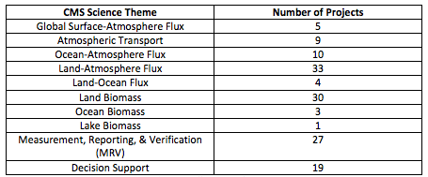
New Product orientation in ARL chart
Tool to centrally locate all information about CMS projects – CMS application information, other WG information, NACP information
Each product has its own line, with a PI confirmed assessment of the ARL level and with information about the product(s) including:
Spatial and temporal resolution, time period, frequency
Science Theme and project objectives
Product Keyword
Application Area
Uncertainty categories
Relevant policies
Future Developments
References
more

Slide 5
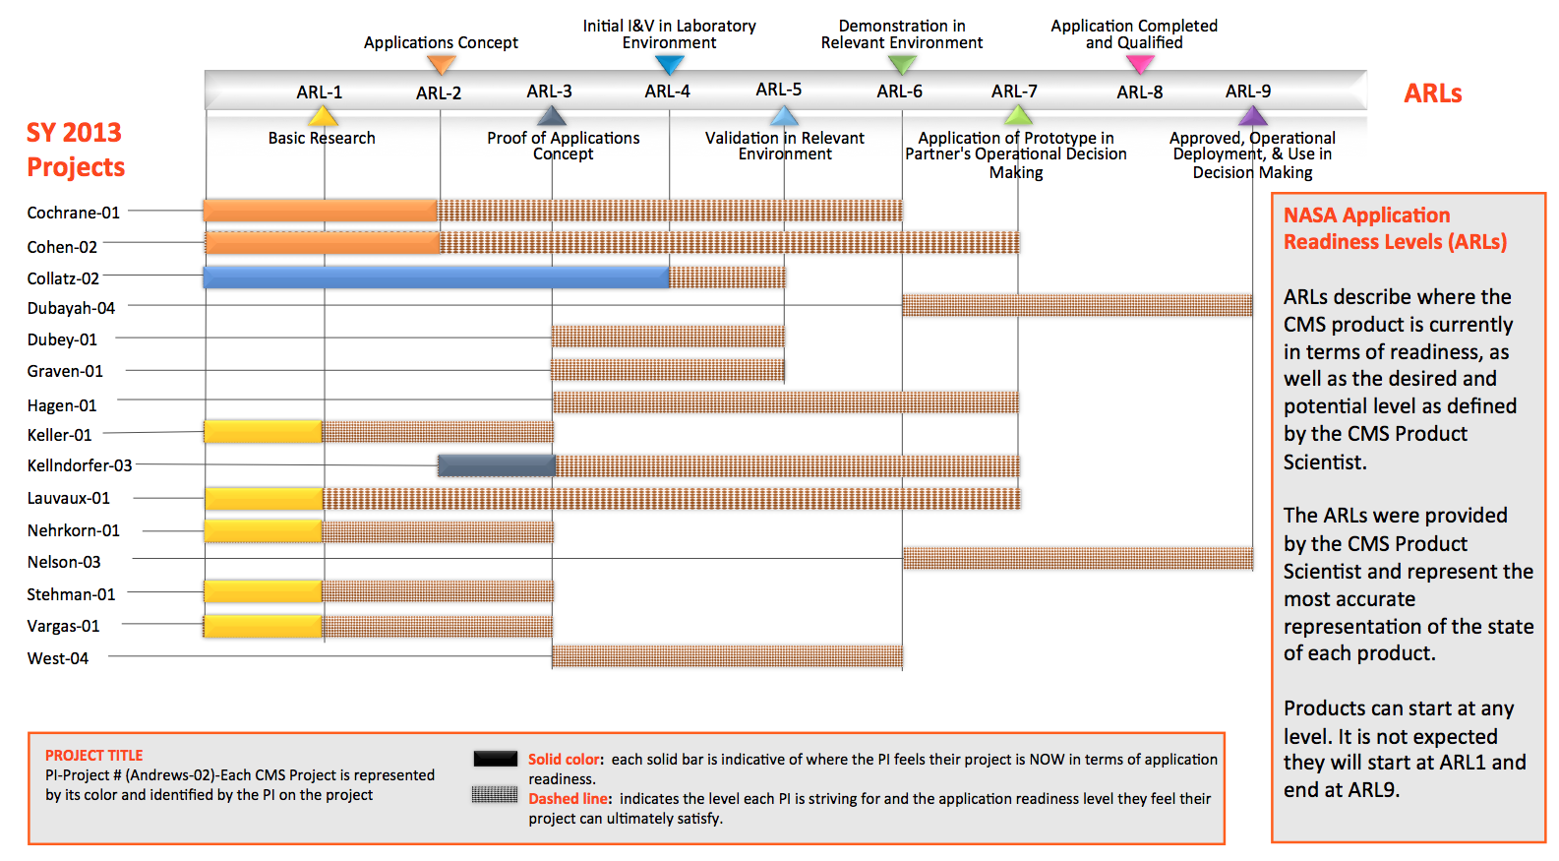
Applications Readiness Levels (ARLs)

Slide 6
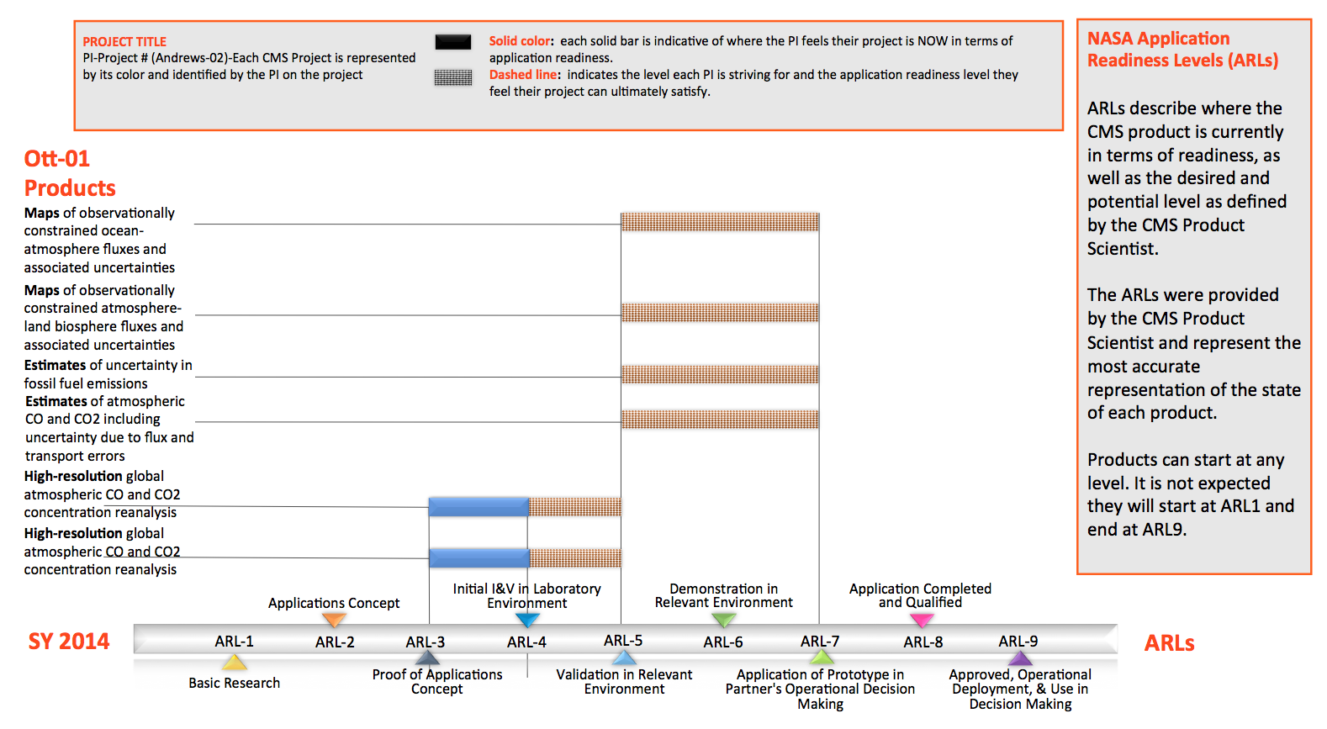
New product-focused ARL Chart

Slide 7
Stakeholder needs
Working with stakeholders to better understand what type of carbon information they need and how they can use CMS products
Bringing them to Goddard to speak about their organization and decision making process through the CMS Applications Policy Series
Speaker | Topic
Tom Robinson and Karen Gaffney of Sonoma County Agricultural Preservation and Open Space District | “Climate and Conservation: Tools and data at the scale of land use decision-making”
Emily Pidgeon, Conservation International’s Strategic Marine Initiatives | "Blue Carbon: A transformational tool for marine management and conservation globally"
Christine Conn and Rob Feldt, Maryland Department of Natural Resources | "Maryland Department of Natural Resources Applications Using LiDAR Data: The Big Picture" & "Better Forest Management Decisions Using LiDAR Products"
Nalini Chhetri, Julie Anne Wrigley global Institute of Sustainability | "Boundary Processes in the Development of Phoenix's Greenhouse Gas Emissions Inventory for Operations"
Melissa Weitz, US Environmental Protection Agency | "Methane in the Inventory of the U.S. Greenhouse Gas Emissions and Sinks"
Kate Calvin Joint Global Change Research Institute (JGCRI) | "Representation of the Terrestrial System in Integrated Assessment Models"
Daniel Sarewitz Consortium for Science, Policy and Outcomes | "Uncertainty is Political!"
Jeffrey Watters Ocean Conservancy | "Ocean Acidification: Connecting Science with Those Who Need It"
Jeremy Freund Wildlife Works Carbon | "Protection in the Tropics: Reference Levels and MRV – Remote Sensing, In-Situ or Both?"
Notes:
I would mention most talks are on line and slides are avaialble through the CMS.nasa.gov website

Slide 8
Evaluation Studies using economic models
To evaluate potential applications of CMS data products, we use specific context in which the data is used to define value of the data. Steps in this process will involve:
Identifying the case study to be examined
Conducting a literature review related to the issues identified
Interviewing experts and staff familiar or involved with the case study.
Identification of policy and regulation issues, and issues in the use of CMS data products to implement that policy or regulation. Also, identification of alternative assumptions relevant to the economic analysis.
Development of an economic model to estimate how impact valuations are affected by better CMS data products.
Conducting model simulations that explore economic impacts and their sensitivity to alternative data availability and assumptions.
Reporting lessons learned based on model predictions and information from the literature review and interviews.

Slide 9
Summary of Methodology
The information has value if the programs have value
Analysis of forestry programs
Lawn to Woodland Program (newest)
Conservation Reserve Enhancement Program
Environmental Quality Incentive Program
Urban Tree Canopy Initiative
Woodland Incentive Program
Discussion of data products used by local, county, state, and federal actors to implement and track forestry programs and how these techniques could be improved by using updated lidar data
Notes:
*The information has value if the programs have value (this is the underlying idea of our entire methodology..I will make this very clear)
*Give a concrete justification of the returns from the forestry programs, and discuss how the data can make the programs even more successful
*first measure the value of the current programs and discuss how updated data products can improve that value
*Once we have establish the quantified value of the programs, we can attribute some of that value to monitoring and implementation efforts, which can then be attributed to the lidar data product. For this part of the methodology, we need to understand existing techniques and how they could be improved by the data. That’s how the audience can help.

Slide 10
Cost Benefit Analysis in Maryland
Use Cost-Benefit Analysis to determine:
Whether the incentives are large enough for private landowners to participate in the programs
How society has benefited from the increase and improvement of forest cover as a result of the programs thus far
Identify the program to analyze
Identify the time frame over which the net benefits of the program will be analyzed
Net benefits each year =
Annual benefits – Annual costs
Calculate the Benefit-Cost Ratio
Value of all benefits ÷ Value of all costs
Program is valuable if this ratio is >1

Slide 11
FY15 Activities
Complete Economic analysis of MD DNR Lidar data use
Two papers expected from this work
Literature review on relevant impact/cost benefit analysis
Complete ARL and product table, continue work on revising web site to enable visitors interested in finding CMS data and information more easily
CMS Website with active hyperlinks to ARL Table, Product Fact Sheet and PI products and Stakeholder agencies(s)
Continue the CMS Applications Policy Speaker Series, with posted talks and recordings of their presentations
Institute a quarterly telecon with interested CMS stakeholders and PIs wanting increased interaction
Workshops:
Ocean-related applications and science
Comparing MRV methods

